Slide 1
CA LAB LAB NO#10 KEYPAD Interface

Slide 2
Keypad
In microcontroller keypad interfacing, push buttons are the major part.
Working of a push button is very simple.
Whenever a push button is pressed it conducts and act as a single line, otherwise it act as a open line and conducts nothing.

Slide 3
How Keypads Work
The buttons on a keypad are arranged in rows and columns.
A 3X4 keypad has 4 rows and 3 columns, and a 4X4 keypad has 4 rows and 4 columns

Slide 4
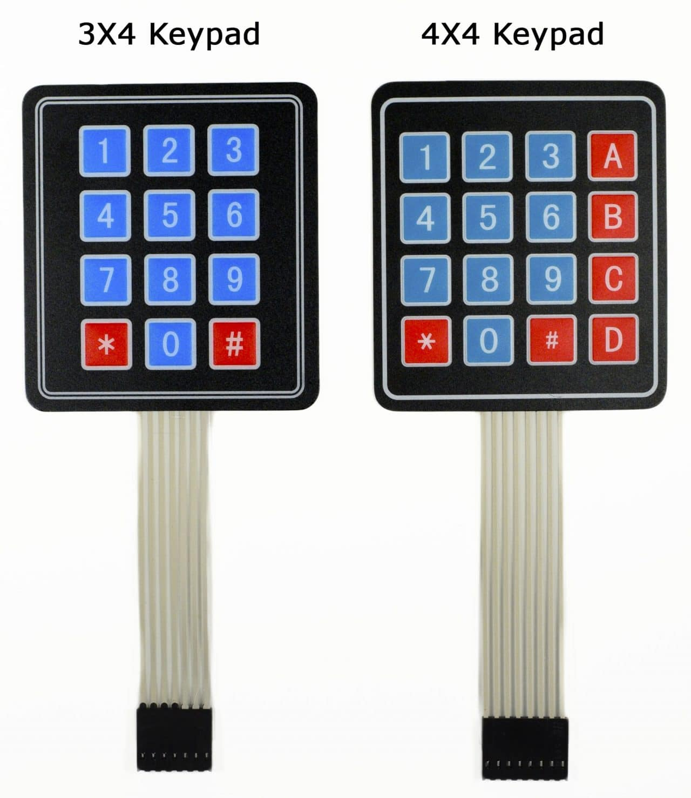

Slide 5
How Keypads Work
Beneath each key is a membrane switch. Each switch in a row is connected to the other switches in the row by a conductive trace underneath the pad. Each switch in a column is connected the same way – one side of the switch is connected to all of the other switches in that column by a conductive trace. Each row and column is brought out to a single pin, for a total of 8 pins on a 4X4 keypad.

Slide 6
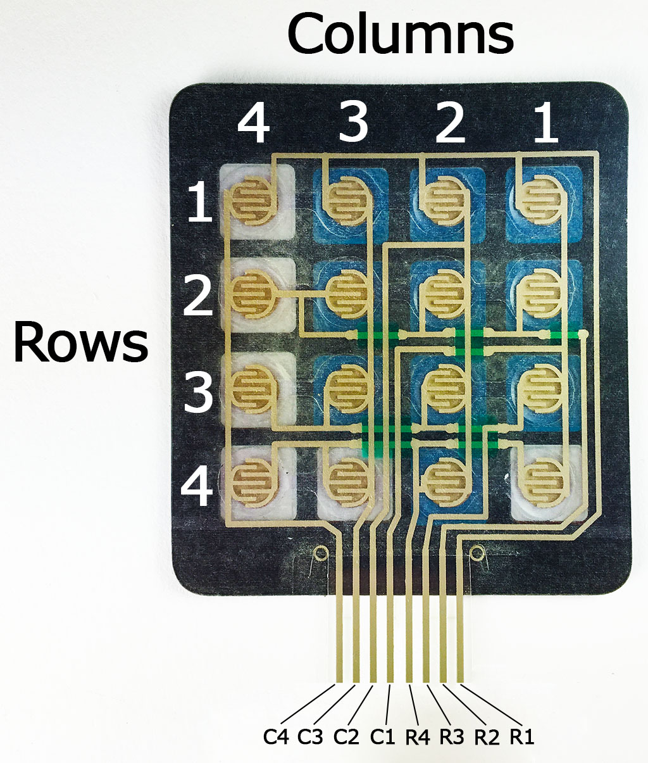

Slide 7
Pressing a button closes the switch between a column and a row trace, allowing current to flow between a column pin and a row pin.
The Arduino detects which button is pressed by detecting the row and column pin that’s connected to the button.
It happens in 4 steps.

Slide 8
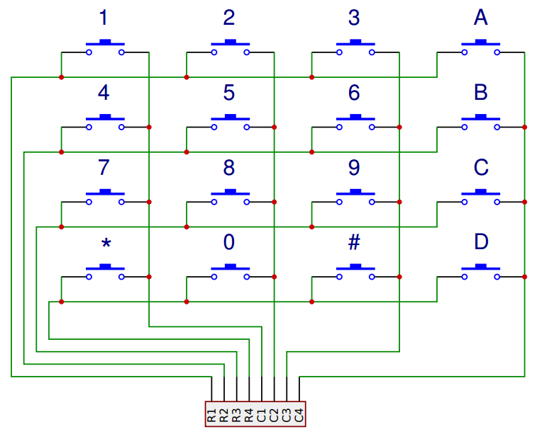

Slide 9
STEP 1
First, when no buttons are pressed, all of the column pins are held HIGH, and all of the row pins are held LOW.

Slide 10
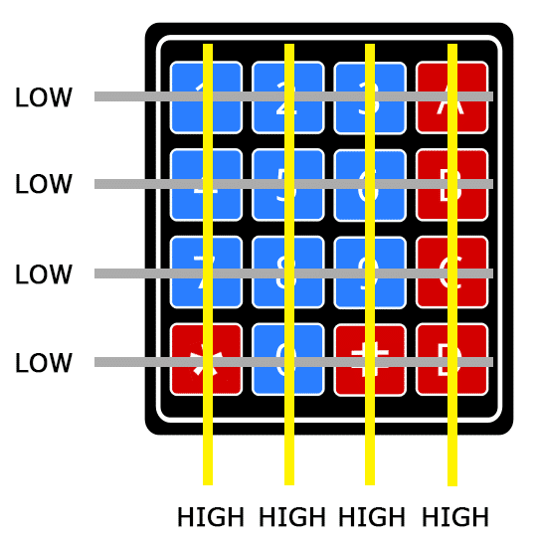

Slide 11
STEP2
When a button is pressed, the column pin is pulled LOW since the current from the HIGH column flows to the LOW row pin.

Slide 12
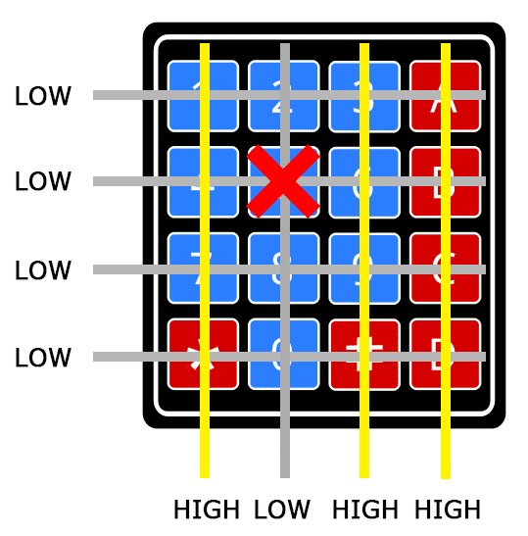

Slide 13
STEP3
The Arduino now knows which column the button is in, so now it just needs to find the row the button is in. It does this by switching each one of the row pins HIGH, and at the same time reading all of the column pins to detect which column pin returns to HIGH.

Slide 14
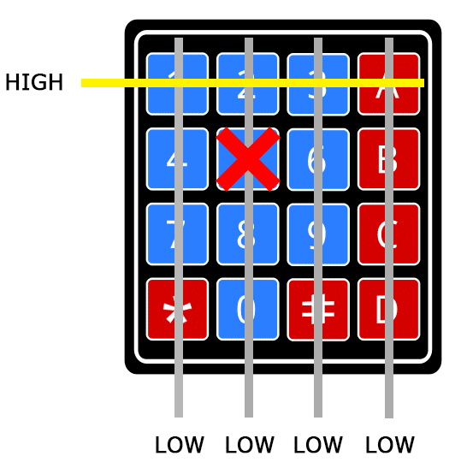

Slide 15
STEP4
When the column pin goes HIGH again, the Arduino has found the row pin that is connected to the button.

Slide 16
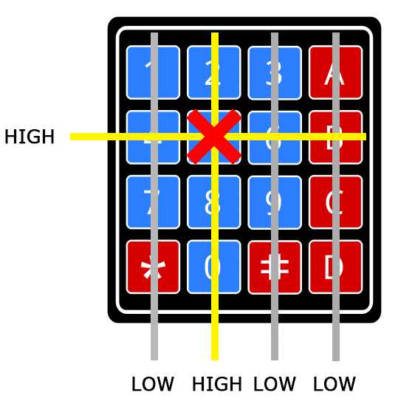

Slide 17
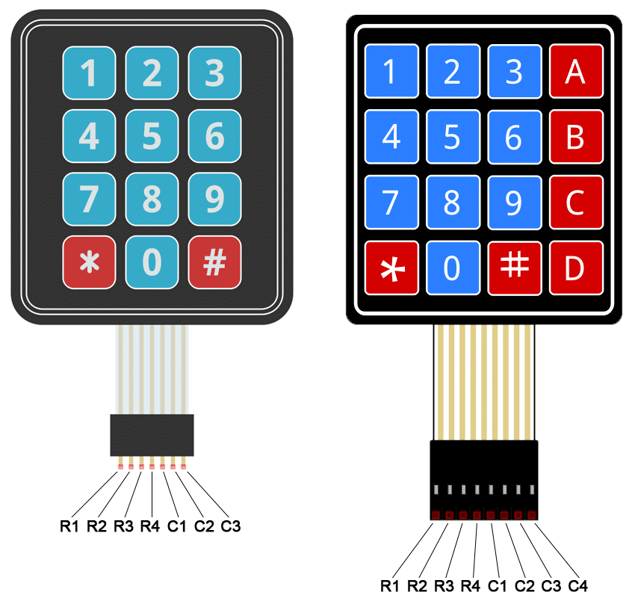

Slide 18
